Slide 1
Event Management System
Presented by: Sandhiya P,
Sachika M S,
Sree Gousalya V

Slide 2
INTRODUCTION:
Project Purpose:
The primary goal of this project is to develop a user-friendly and robust Event Management System. It aims to streamline the entire event lifecycle, from initial planning and promotion to user registration and post-event analysis.
Objectives:
The key objectives are to provide a platform where users can easily register for events and view all necessary details, such as schedules and locations. Additionally, the system will offer organizers powerful tools to efficiently manage event logistics and communicate effectively with attendees.

Slide 3
Problem Statement:
The project is needed because managing events is often difficult and messy. Organizers have to use many different tools like spreadsheets and emails, which takes a lot of time and can lead to mistakes. At the same time, people who want to attend events have trouble finding information and keeping track of their registrations. This project solves these problems by creating one easy-to-use platform. This system will make it simple to create events, register for them, and see all the details in one place, which helps both the organizers and the attendees.

Slide 4
Features:
Event Creation: A platform for creating and managing events.
User Registration: Allows users to register for events.
Event Details: Users can view event details.
Login Interface: Includes a login page with fields for event name, date, and location.
Interactive Design: Features a responsive layout with event cards that expand to show more details upon clicking

Slide 5
Tech Stack:
Backend: Spring Boot (Assuming this is a full-stack project based on the request)
Database: MySQL (Assuming this is a full-stack project based on the request)
Frontend: HTML, CSS, JavaScript (The provided HTML file contains these elements). The frontend is titled "Event Management System".

Slide 6
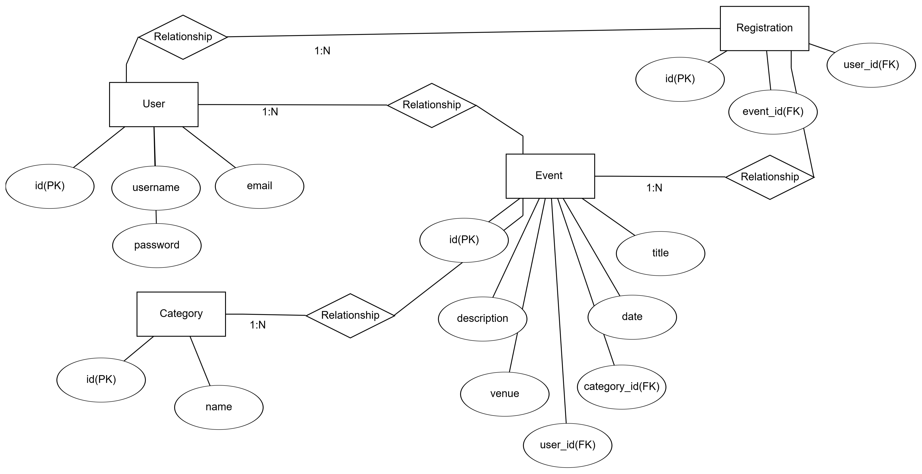
ER Diagram:
A diagram showing entities like User, Event, and Registration, along with their attributes and relationships.

Slide 7
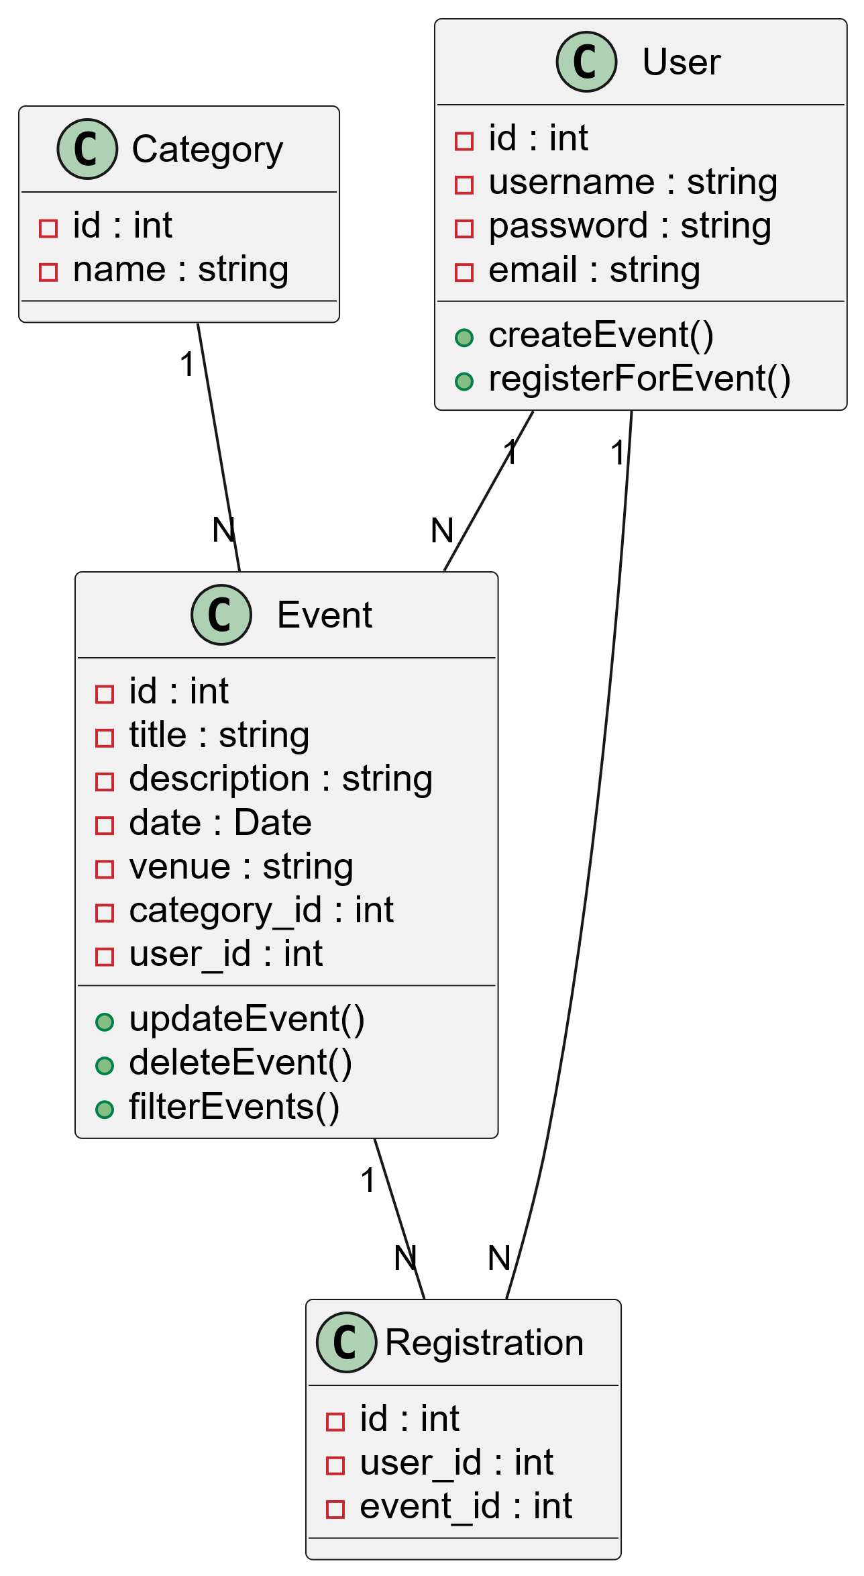
UML Diagrams:
A diagram representing the classes of the system, their attributes, and relationships.

Slide 8
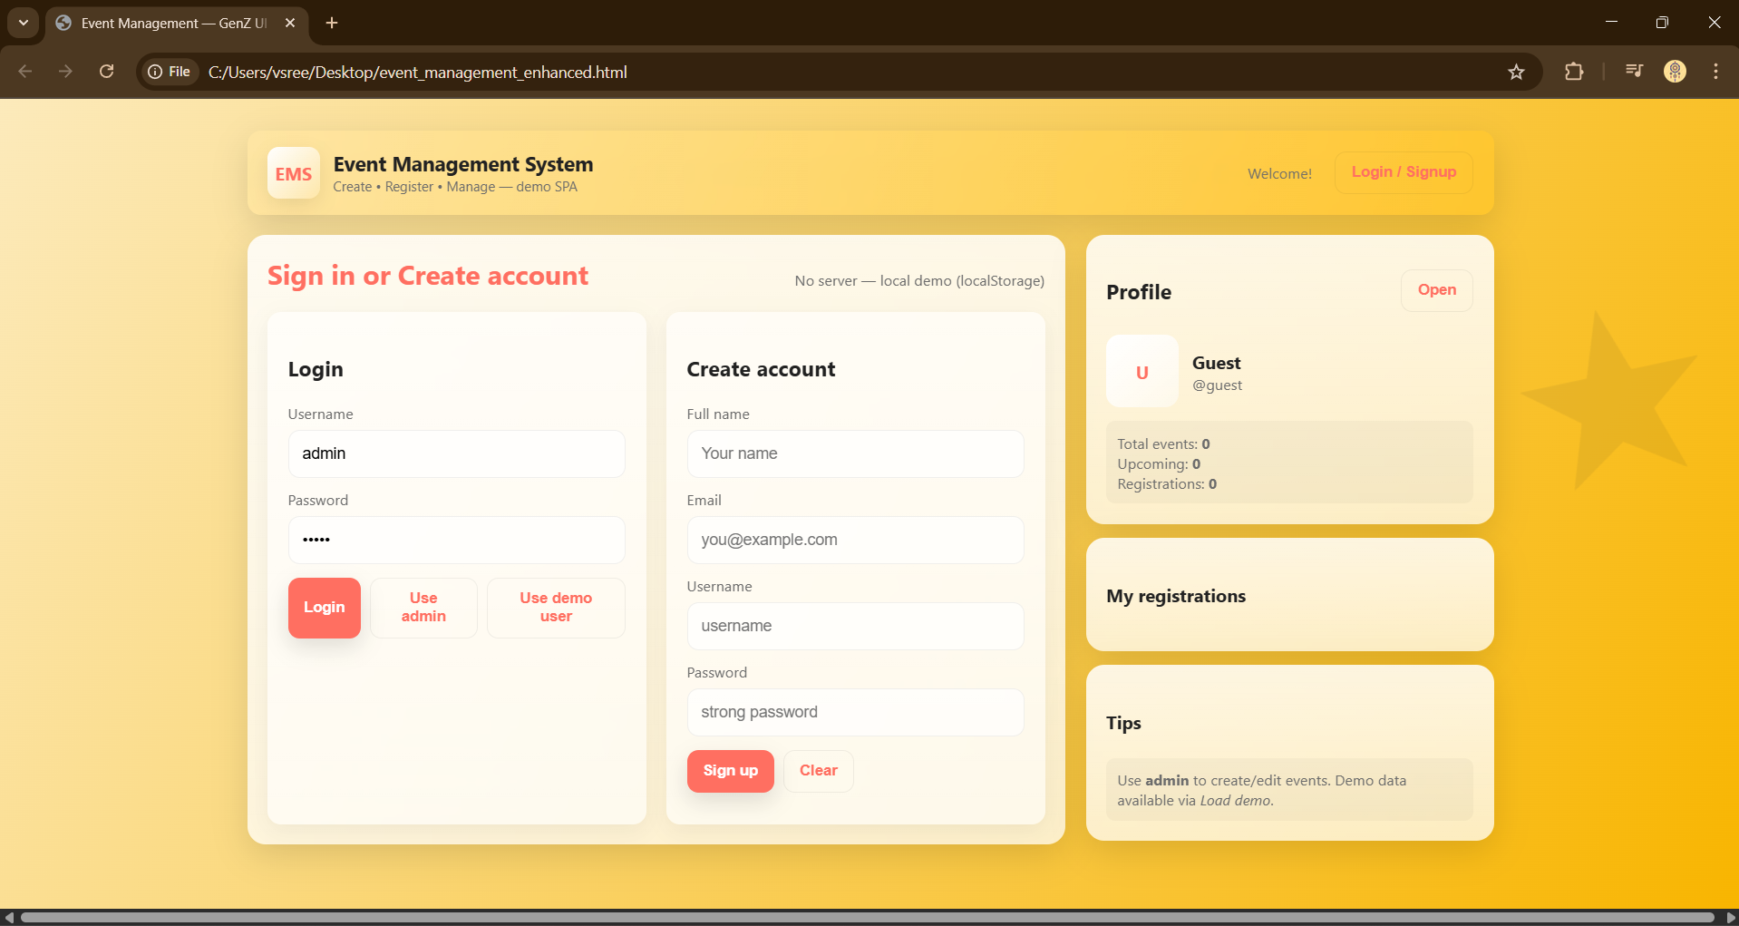
Demo:

Slide 9
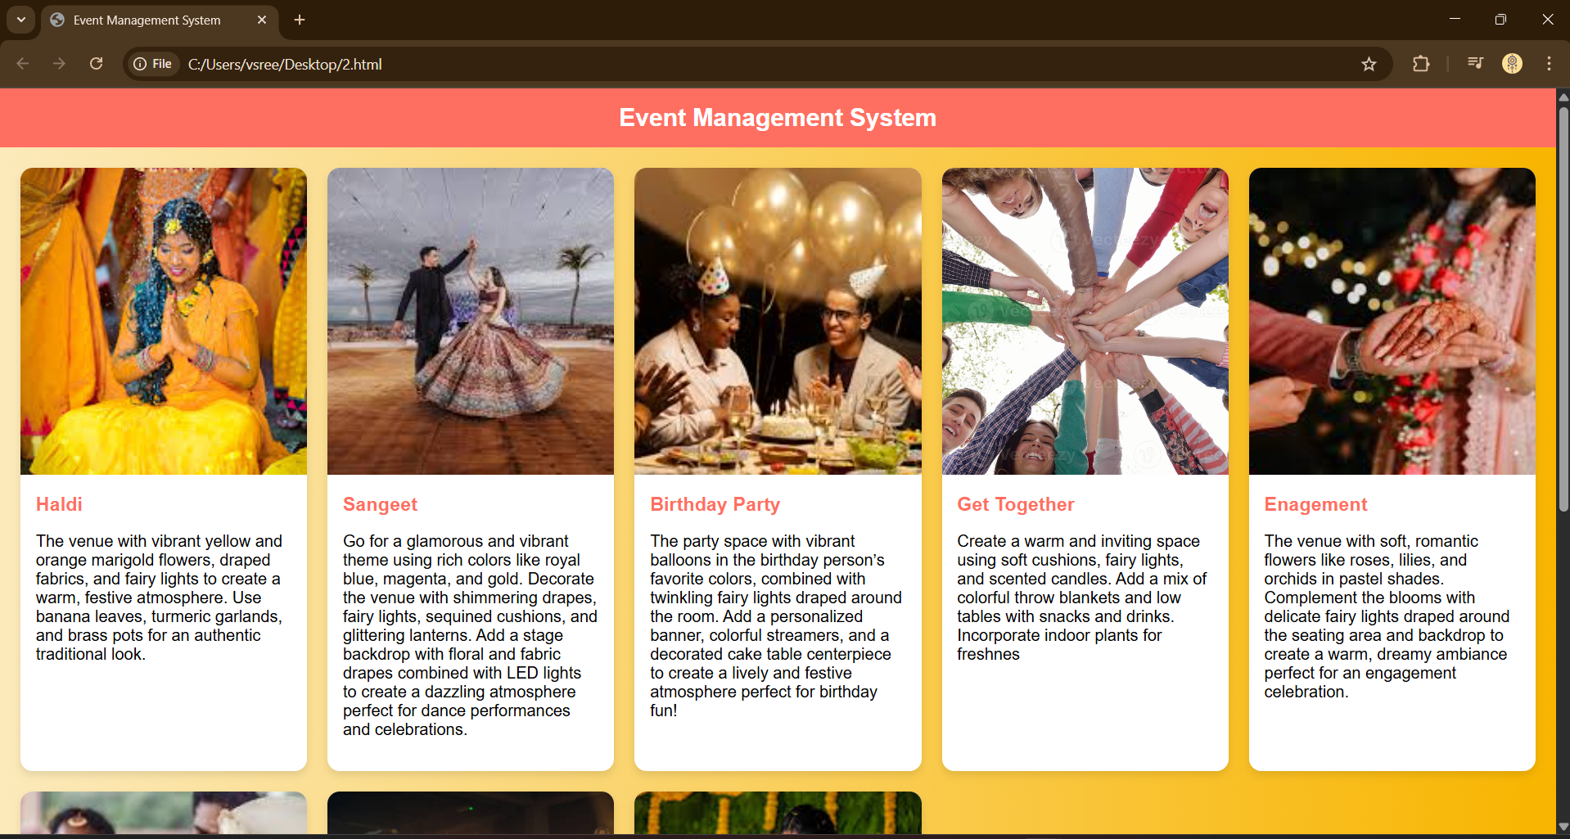

Slide 10
Challenges Faced:
Database Connectivity:
We had to work through issues connecting our Spring Boot application to the MySQL database. This involved correctly configuring settings and making sure the database was running and accessible.
Styling/UI:
Issues with implementing a consistent and responsive user interface.
Dependency Management:
We encountered problems with different versions of libraries, which caused errors and required careful management of our project's dependencies.

Slide 11
Future Enhancements:
Notifications: Implement email or in-app notifications for event updates.
Multi-user Support: Expand the system to support multiple user roles (e.g., event organizers, attendees) with different permissions.
Payment Gateway Integration: Add the ability for users to pay for events during registration.

Slide 12
Conclusion:
Summary:
The project successfully created an Event Management System that allows users to register for and manage events.
Learning Outcomes:
Gained experience in developing a full-stack application using Spring Boot, MySQL, and a modern frontend framework/library.

